Slide 1
Packed Lunches
Workshop

Slide 2
Fussy Eaters
It's natural to worry whether your child is getting enough food if they refuse to eat sometimes.
But it's perfectly normal for toddlers and young children to refuse to eat or even taste new foods.
Do not worry about what your child eats in a day or if they do not eat everything at mealtimes. It's more helpful to think about what they eat over a week.
If your child is active and gaining weight, and they seem well, then they're getting enough to eat.
As long as your child eats some food from the 4 main food groups fruit and vegetables
starchy carbohydrates such as potatoes, bread, rice, pasta
dairy or dairy alternatives
beans, pulses, fish, eggs, meat and other proteins

Slide 3
Children with additional needs
Nutrition and dietetic service for children with special needs in Luton
The Paediatric Dietetic service is a team of registered dietitians who offer specialist dietary advice and support to families of children and young people aged between 0 to 19 years old. Our service accepts referrals from GPs, consultants, nurses and other health professionals (e.g physiotherapists, speech and language therapists). If your child’s referral cannot be accepted by us you can get support from other teams, including:
health visitors and community nursery nurses
local weight management services
school nurses
GP practice nurses
Children and their families are seen in clinic, either at the Edwin Lobo Child Development Centre or at a health centre. A choice of dates and times will be offered when booking an appointment.
The service will assess children where there are worries about them:
gaining weight too slowly
gaining weight too fast
not eating many different foods or having to avoid some foods

Slide 4
Your child’s dietitian will undertake a full assessment and provide individual dietary advice on how best to improve their nutrition.
When you stop having appointments with the dietitian you will have a plan to follow at home. Your child can always be re-referred in the future if more advice is needed.
Websites and apps which you may find useful are:
The British Dietetic Association - look for the Food Fact Sheet link on the homepage for information
Change for Life website and apps
Mencap
The Caroline Walker Trust
Who to contact
Telephone
01582 707400
E-mail
ccs.beds.nutrition@nhs.net
Website
Nutrition and dietetic service for children with special needs in Luton website
Where to go
Name
Nutrition & Dietetic Service
Address
Dunstable Health Centre
Priory Gardens
Dunstable
Bedfordshire
Postcode
LU6 3SU

Slide 5
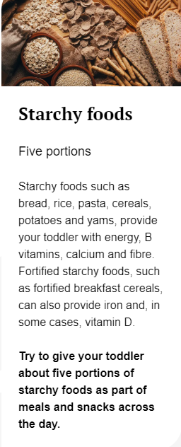
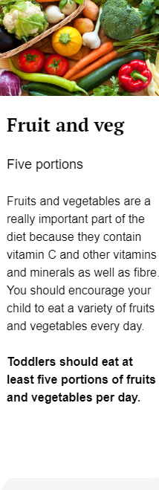
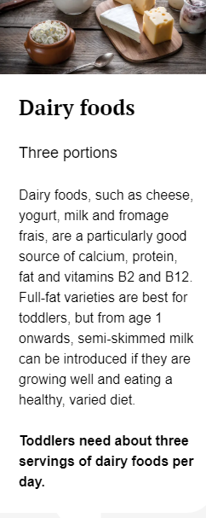
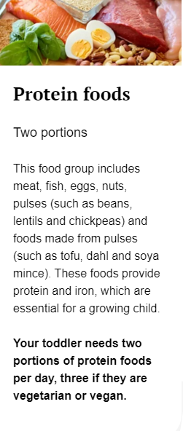
Getting the right amount of everything

Slide 6
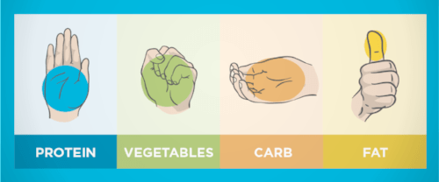
A visual guide to portion size

Slide 7
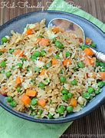
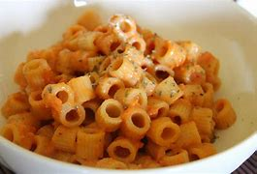
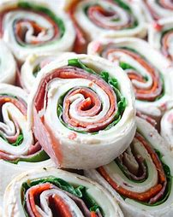
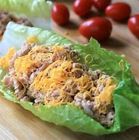

No Sandwich lunches
Lots of young children do not like sandwiches and that’s ok.
Find alternatives that they do like eating.

Slide 8
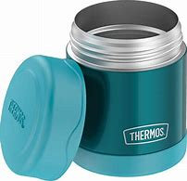
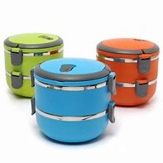
Keeping food hot/warm

Slide 9
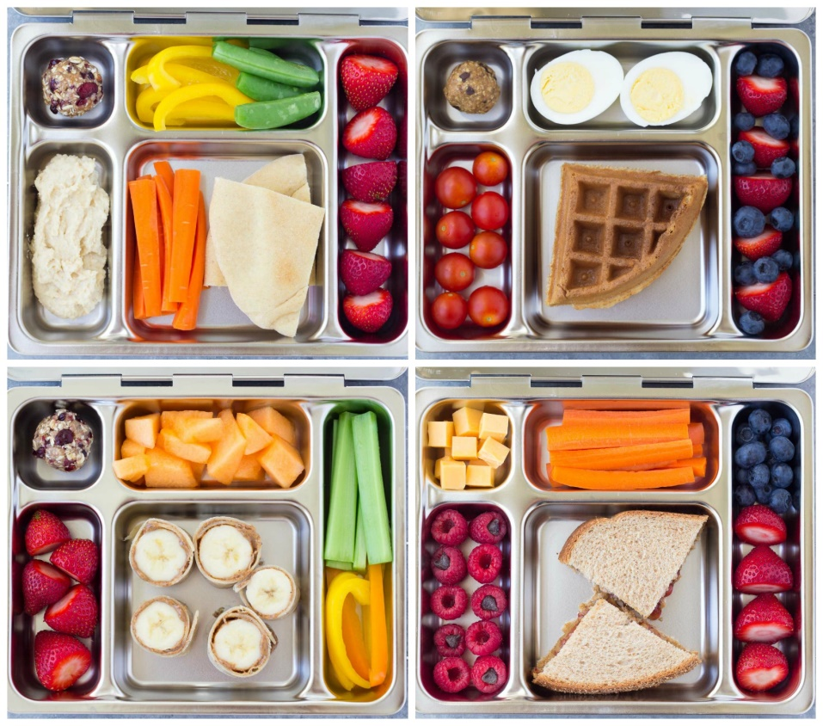
A choice, but not too much

Slide 10
Getting your children involved
Talk to your child to see what they like eating whilst at nursery, they may surprise you and say they prefer eating certain things whilst not at home.
Some children may be able to help, either putting items in the lunch bag, or even preparing the food. E.g. cutting or washing the fruits and vegetables.
Remember no everyone likes the same thing everyday, so giving the children a choice between 2 things can help add a bit of variety to their lunch.
Even going as far as making a menu of what they have each day can encourage children to look forward to lunch time and be excited about their food.

Slide 11

Variety is the spice of lunch!
Be adventurous and get creative to mix up what goes in their lunchbox. Keeping them guessing with healthier ideas will keep them interested and more open to trying things.
Cherry tomatoes, or sticks of carrot, cucumber, celery and peppers all count towards their 5 A Day. Adding a small pot of reduced-fat hummus or other dips may help with getting kids to eat vegetables.

Slide 12
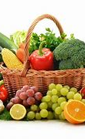
5 a day Fruits and Veg Most of us still are not eating enough fruit and vegetables. They should make up just over a third of the food we eat each day.
Try chopped apple, peeled satsuma segments, strawberries, blueberries, halved grapes or melon slices to make it easier for them to eat. Add a squeeze of lemon juice to stop it from going brown.
Tinned fruit counts too
A small pot of tinned fruit in juice – not syrup – is perfect for a lunchbox and easily stored in the cupboard.

Slide 13
Healthy drinks
Healthy alternatives
Ingredients to be aware of
water
infused water
Caffeine free herbal teas
100% fruit juices
Smoothies
No added sugar
Fizzy drinks and soda
added sugars
artificial sweeteners
tartrazine (yellow no. 5)
red no. 40
blue no. 1
sodium benzoate
potassium sorbate

Slide 14
Cut back on fat
Try to pick lower-fat fillings – like lean meats (including chicken or turkey), fish (such as tuna or salmon), lower-fat spread, reduced-fat cream cheese and reduced-fat hard cheese.
If your child really likes their crisps try reducing the number of times you include them in their lunchbox, and swap for homemade plain popcorn or plain rice cakes instead.
Buy low-fat and lower-sugar yoghurts or fromage frais and add your own fruit.

Slide 15
Keep them full for longer
Base the main lunchbox item on foods like bread, rice, pasta and potatoes. Choose wholegrain where you can.
If your child does not like wholegrain, try making a sandwich from 1 slice of white bread and 1 slice of brown bread.
Keep a small selection of different types of bread in the freezer so you have a variety of options – like bagels, pittas and wraps, granary, wholemeal and multigrain.

Slide 16
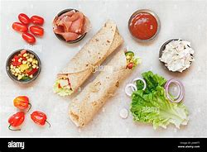
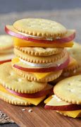
DIY Lunches
Wraps and pots of fillings can be more exciting for kids when they get to make them.
Crackers with small slices of cheese and meats means independence and mix and match

Slide 17
Important things to remember
Cut small foods in half, such as: grapes, tomatoes, olives to avoid choking hazards.
We are a nut free school, so no nuts at all, including in spreads.
Cut bread thinner to make it easier to eat and cut crusts off sandwiches if your child doesn’t like them, as they will leave them anyway.
Get wrappers prepared so the child can do it themselves e.g. cut the end off the chocolate bar wrapper. Children love to be independent.

Slide 18
Thank you for coming

